Slide 1

What can you do with SPEC? How does it work?
Alex Grasman
Martin van Hees

Slide 2

Agenda
Background
Overview
Demonstration

Slide 3

Why did MARIN develop SPEC?
Develop our own knowledge
Apply knowledge in the public domain
Support the shipping sector:
What will be the energy carrier(s) of the future?
Support ship owners:
  How will ship designs be affected
  How do we prepare for 2030 / 2050 emission targets?

Slide 4



What is SPEC?
Collection of energy carriers and systems
from publications and symposia
Compare and rank solutions based
on multi-criteria
Previously Excel based
Online Database:
https://sustainablepower.application.marin.nl
Quaestor platform
Dedicated studies performed in several projects to date
Knowledge utilised in many more projects
Notes:
Explain the data knowledge collection from papers and symposia. Comparison tool.

Slide 5
What are the system boundaries in SPEC
Energy carrier
Emissions
Shore grid
Energy carrier
Energy
storage
Pre-treatment and distribution
After treatment
Ships power and propulsion
Any Generator
Any Generator
Electrical storage
VDC
Ships services
Power
Gearbox
M/G
Consumers
Internal Comb Engine
VAC
Ships pay load consumers
Ships services
Consumers
Consumers
Consumers
After treatment
SPEC building blocks in mass-to-power flow:
Energy storage
Pre-treatment
Energy conversion
Power distribution, converters and drives
Notes:
A hybrid configuration is also what MARIN’s ZEL will feature
It allows for different power sources and conversion methods to be used, independently or together:
Auxiliary gensets
Electrical storage
Main propulsion engine
Bi-directional tap on gearbox can increase shaft power delivered by diesel (‘boost’) or power the shaft on its own (source is genset or electrical storage), but the other way also works: increase loading of a diesel at lower speeds, to deliver hotel loads or charge a battery bank

Slide 6
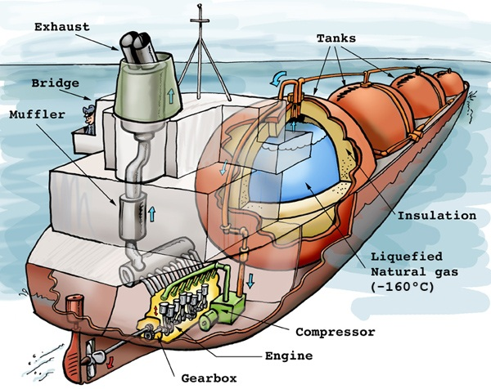
What does SPEC do?
Stored energy
Power systems
Contained energy density
Pre-treatment
Power distribution & drive
Energy to power
After-treatment
Electric distribution
Gear boxes and shafts
Emission information
Properties:
Energy/Power density
CapEx
OpEx
Efficiency
TRL
Notes:
Conversion from energy carrier to power
In this step the type of conversion from carrier to physical power is made. F.e. by Internal Combustion Engine (ICE) [bkW] or Fuel Cell [ekW]. Some of the carriers have multiple possibilities. F.e. methanol can be burned in an ICE, but from methanol separated hydrogen (called ‘dehydrogenation’) can also be processed in a fuel cell.
Energy carrier pre-treatment
Some energy carriers do not have the right appearance for power conversion. What type of physical or chemical conversion must be applied depends on the type of power conversion
F.e. 250 bar compressed natural gas has expand to 5-10 bar for streaming into the air inlet system of an ICE.
Exhaust after treatment
ICE conversions sometimes require after treatment as per IMO Tier III or EU Stage V. This will prevent exhaust gasses to emit (excessive) amounts of harmful substances, like NO_{x} and Particulate Matter

Slide 7


What does SPEC do?
Stored energy
Power systems
Contained energy density
Pre-treatment
Power distribution & drive
Energy to power
After-treatment
Electric distribution
Gear boxes and shafts
Emission information
AND
???
Properties:
Energy/Power density
CapEx
OpEx
Efficiency
TRL
Notes:
Conversion from energy carrier to power
In this step the type of conversion from carrier to physical power is made. F.e. by Internal Combustion Engine (ICE) [bkW] or Fuel Cell [ekW]. Some of the carriers have multiple possibilities. F.e. methanol can be burned in an ICE, but from methanol separated hydrogen (called ‘dehydrogenation’) can also be processed in a fuel cell.
Energy carrier pre-treatment
Some energy carriers do not have the right appearance for power conversion. What type of physical or chemical conversion must be applied depends on the type of power conversion
F.e. 250 bar compressed natural gas has expand to 5-10 bar for streaming into the air inlet system of an ICE.
Exhaust after treatment
ICE conversions sometimes require after treatment as per IMO Tier III or EU Stage V. This will prevent exhaust gasses to emit (excessive) amounts of harmful substances, like NO_{x} and Particulate Matter

Slide 8
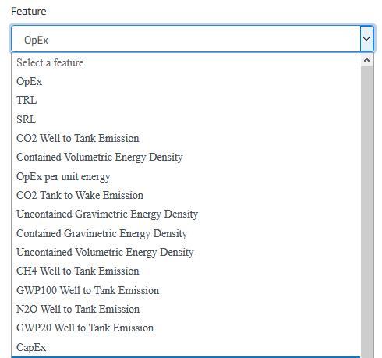

Energy carriers and their characteristics
992 records of energy carrier properties
to date

Slide 9
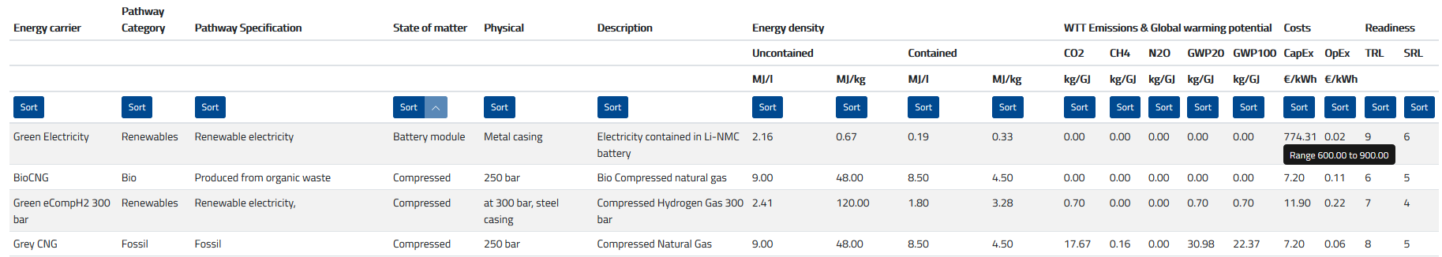
Energy carriers and their characteristics
Contained energy density is incl. weight/volume of storage medium
WTT, Well-to-Tank emission from the energy carrier production and distribution
Energy carrier CapEx are captial expenses for energy carrier storage
TRL = Technical Readiness Level of the energy carrier storage

Slide 10
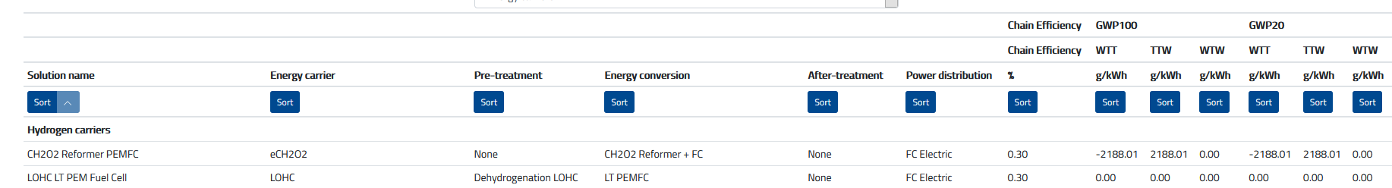
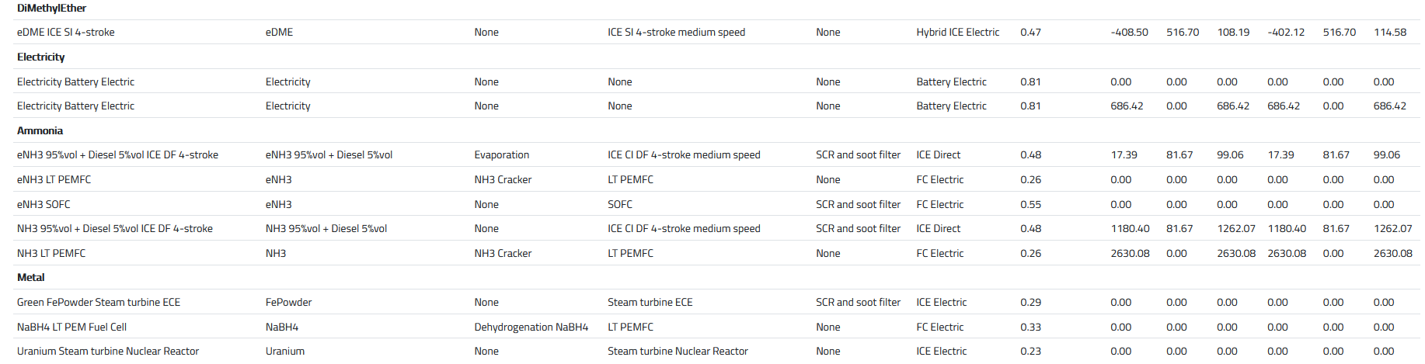
Solutions: Ship Power and Energy System
= Energy storage + Pre-treatment + Energy conversion + After-treatment + Distribution
Emissions given per unit of energy delivered by the system to the consumers
WTW = Well-to-Wake: emissions from production and the ship itself

Slide 11
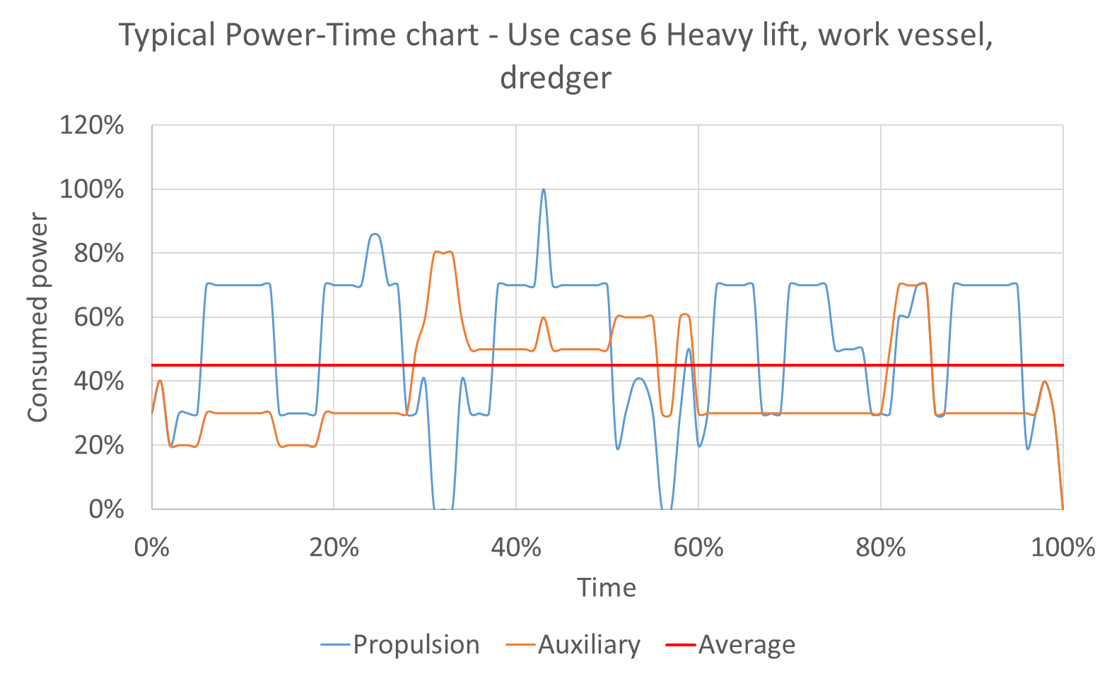
Example: Heavy Lift Vessel
Average power = 45%
Installed = 22 MW
Autonomy = 700 hours

Slide 12
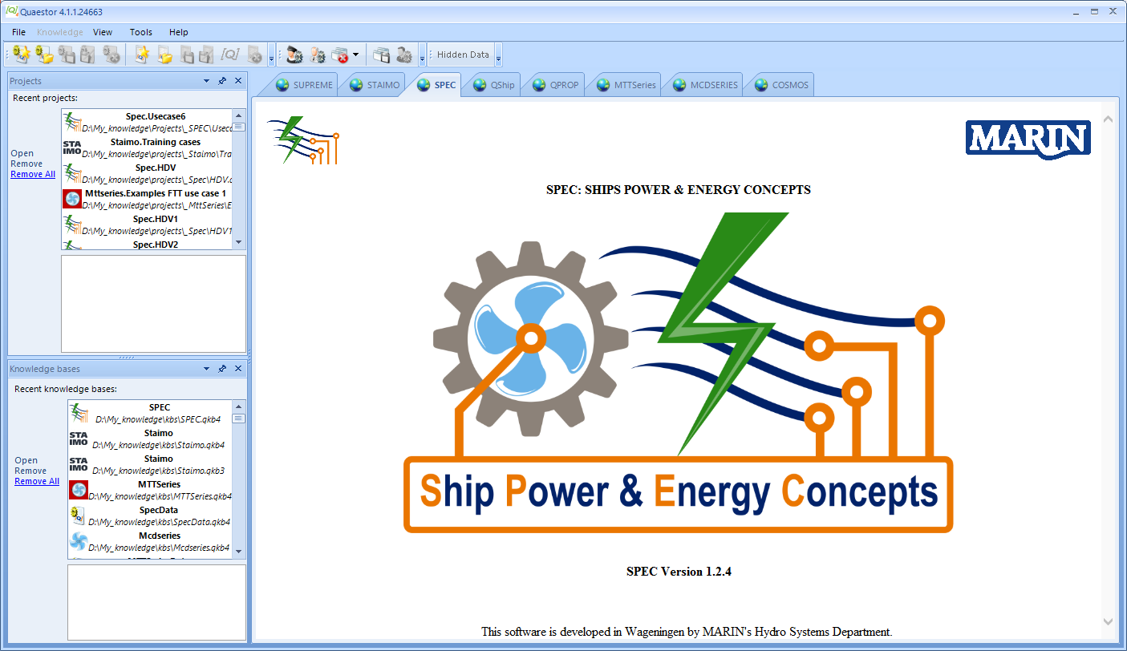

Slide 13
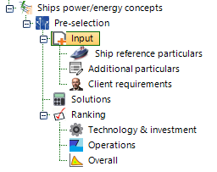
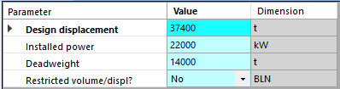

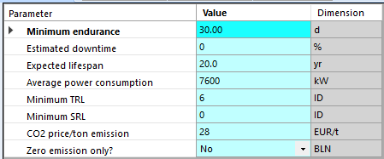
Using SPEC: Preselection of system concepts

Slide 14
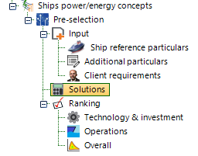
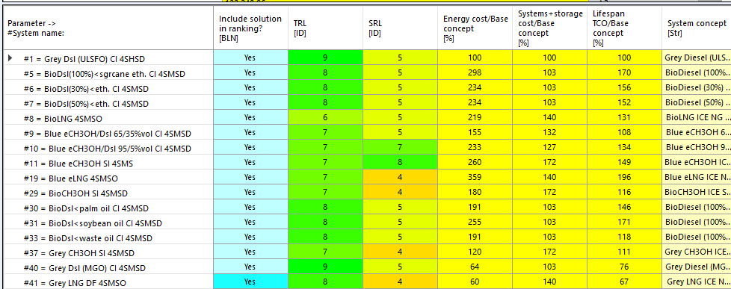
Using SPEC: Preselection of system concepts
List of compliant solutions from 43 energy system concepts

Slide 15
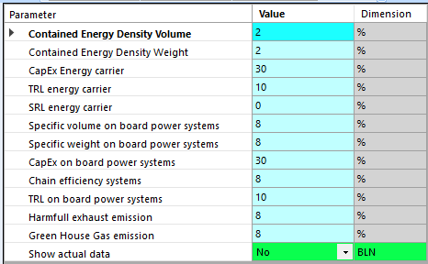
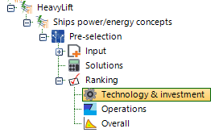
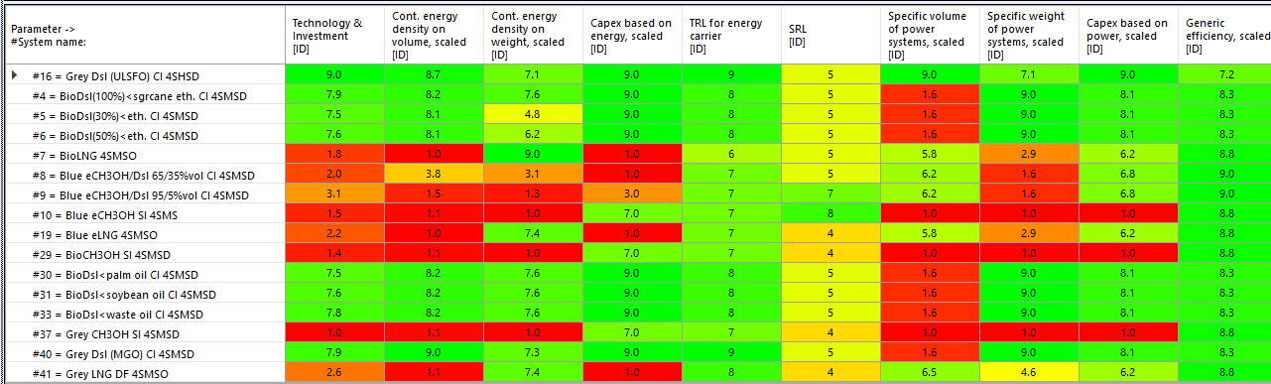
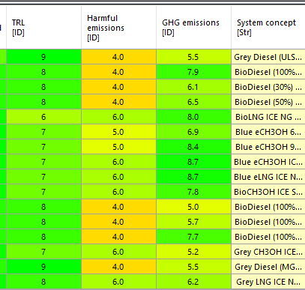
Using SPEC: Ranking of system concepts

Slide 16
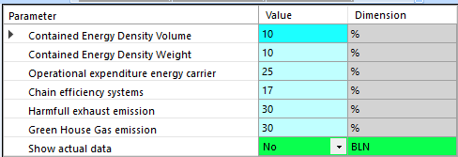
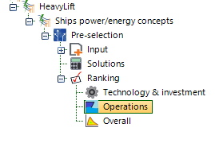
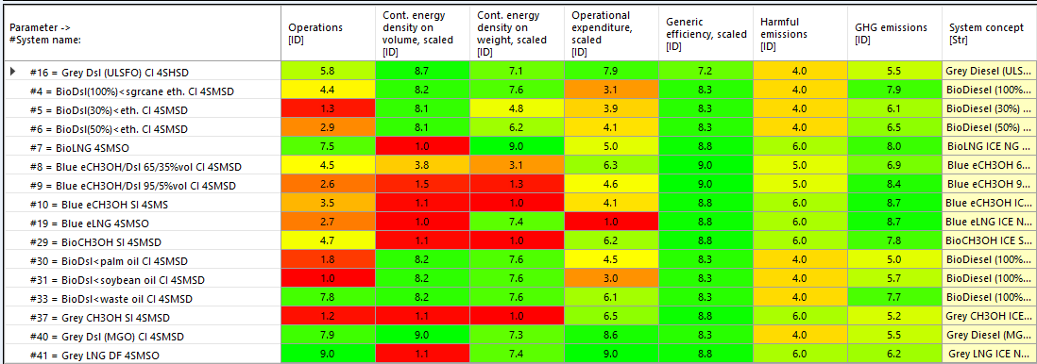
Using SPEC: Ranking of system concepts

Slide 17
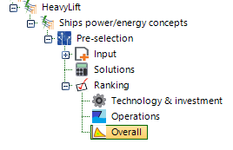

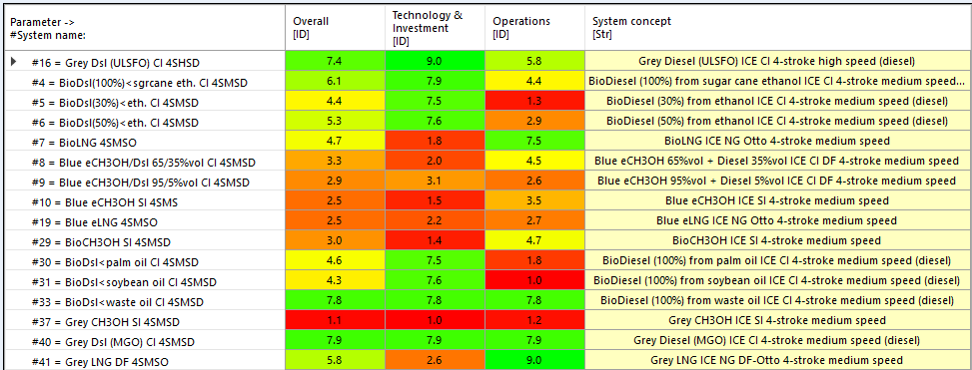
Using SPEC: Ranking of system concepts

Slide 18
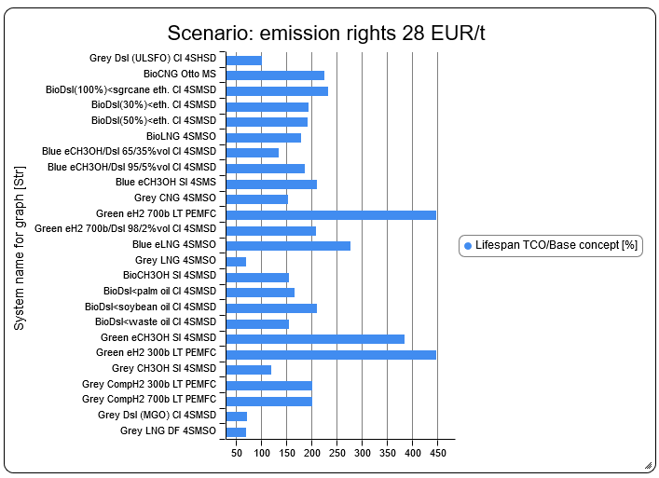
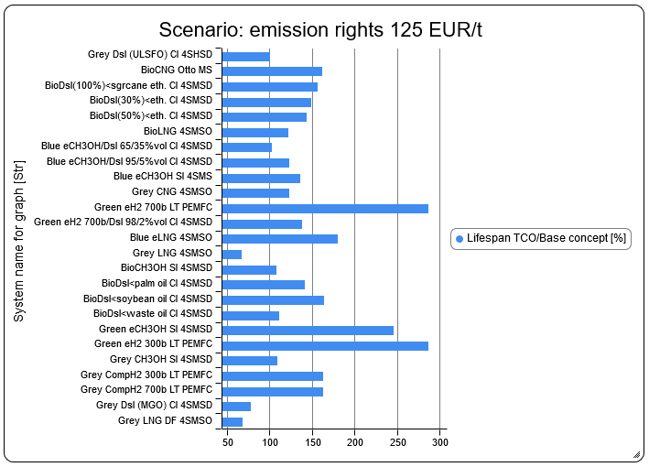
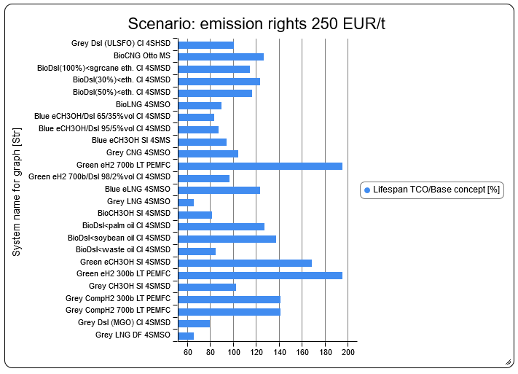
Effect analysis: TCO versus CO2 emission rights

Slide 19
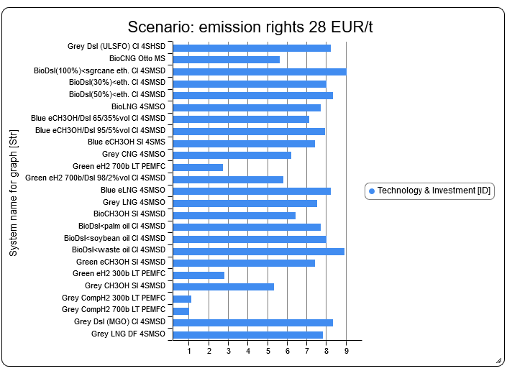
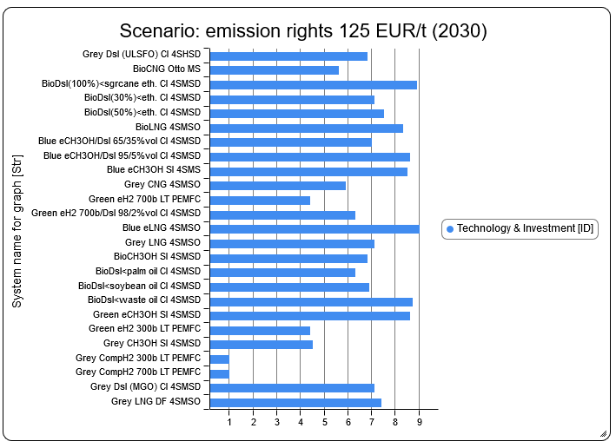

Effect analysis: Ranking technology and investment

Slide 20
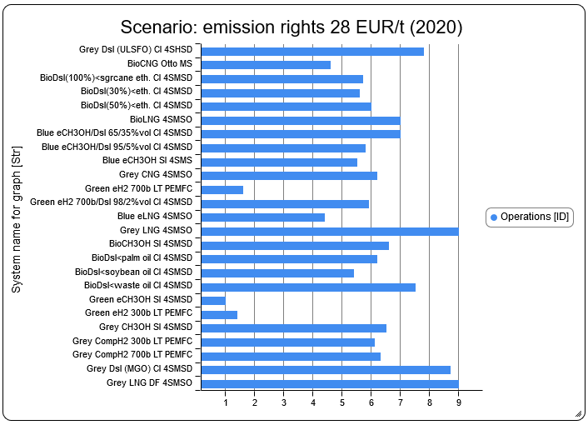
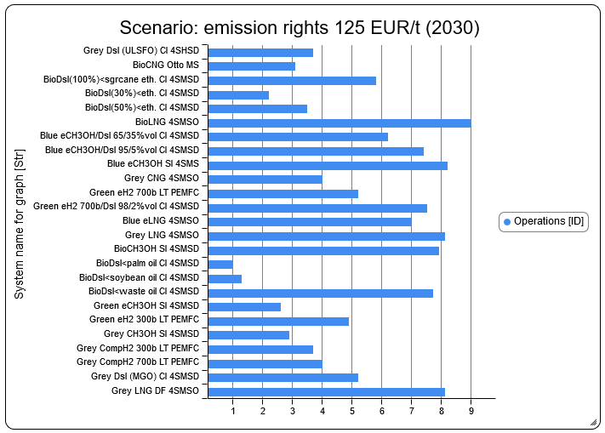
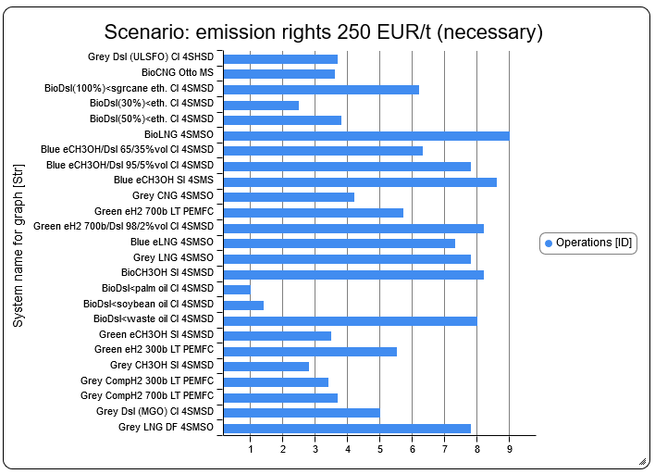
Effect analysis: Operations ranking

Slide 21
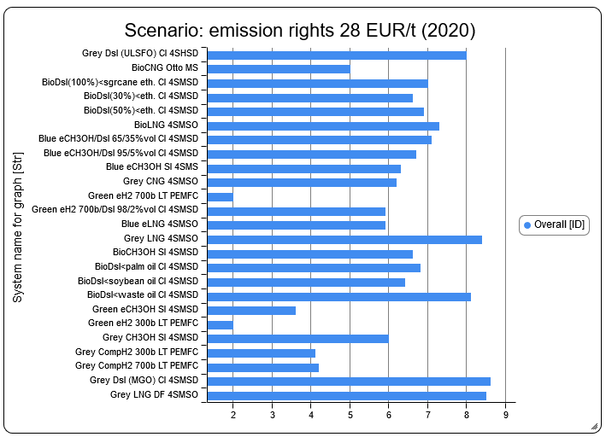
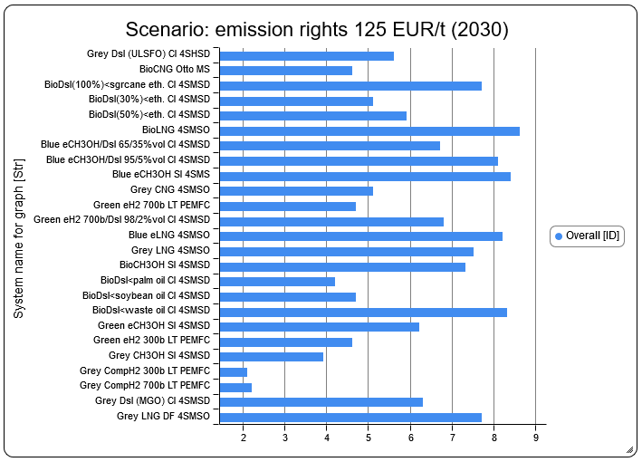
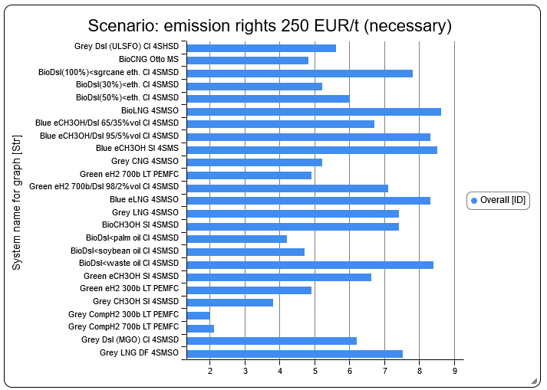
Effect analysis: Overall ranking

Slide 22
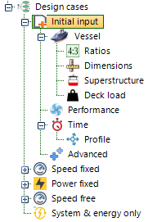
Using SPEC: Design cases
Design cases:
  Impact of system concept op main particulars, payload, speed, power etc.
  Tuning of parameters with benchmark vessels
  Input independent from Pre-selection
  Input in different forms, ratios, dimensions, installed power, speed…
  Lifespan, downtime, power profile, endurance

Slide 23
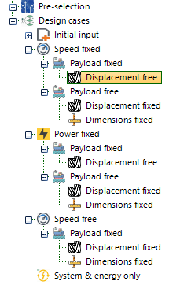
Using SPEC: Design cases
Three main design cases:
  Speed fixed with three variants
  Power fixed with three variants
  Speed free with two variants
In total 8 design cases with combinations
  Speed
  Power
  Payload
  Displacement
  Dimensions

Slide 24
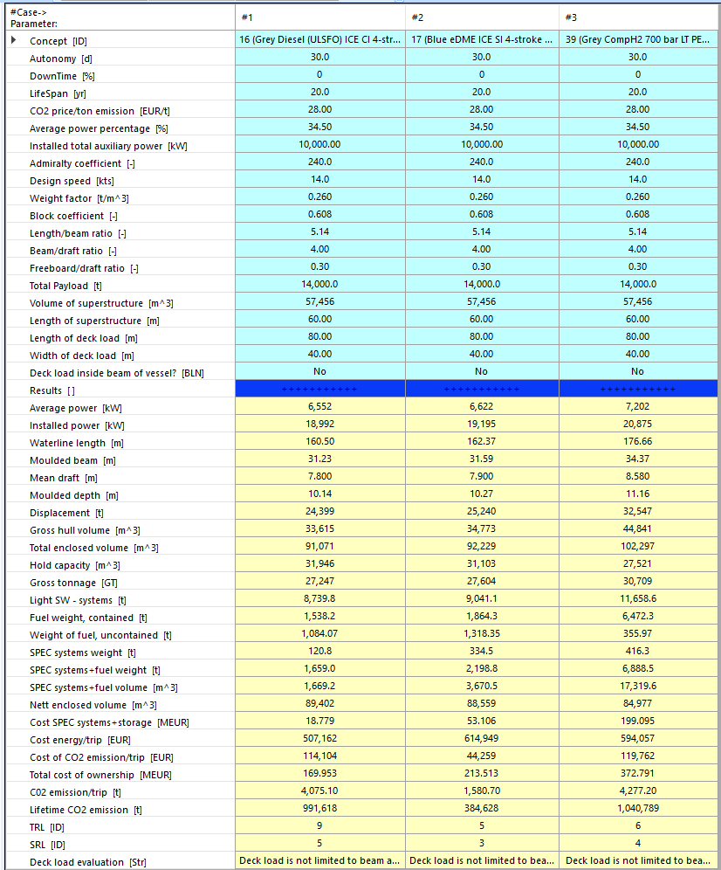
Using SPEC: Design cases, variation of system concept

Slide 25
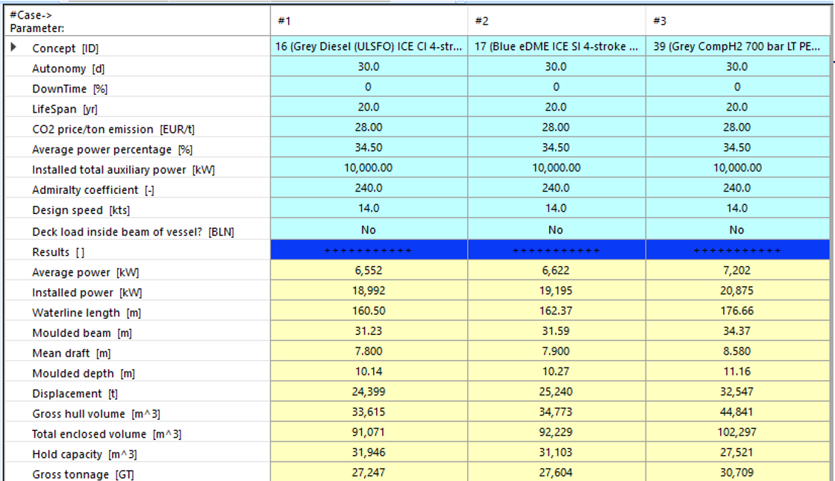
Using SPEC: Design cases, variation of system concept

Slide 26
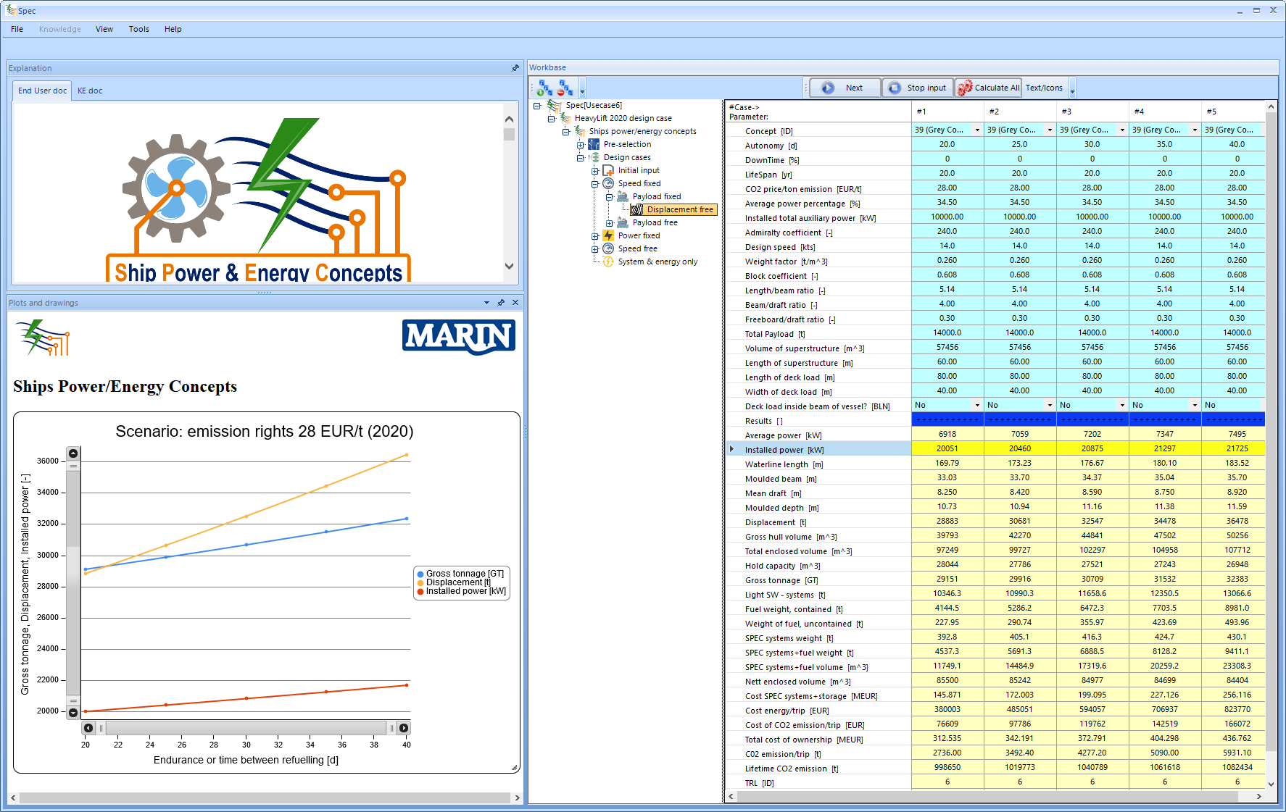
Using SPEC: Design cases, variation of endurance

Slide 27
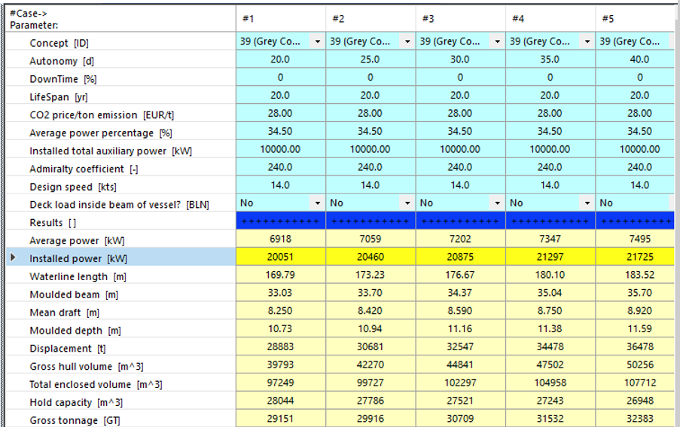
Using SPEC: Design cases, variation of endurance

Slide 28
Summary
SPEC is a conceptual design tool that can assess the performance of energy- and power systems, based on the ship design and its mission (endurance, payload, etc..);
Do you want to find out what alternative energy- and power systems are suitable for your ship?
And how the ship design and operations will be affected?
Get in touch: a.grasman@marin.nl
Our database (in development) can be found here: http://sustainablepower.application.marin.nl
(we are open to suggestions for data improvement!)

